Slide 1
Co-labhairt Comann Ainmean-àite na h-Alba
Scottish Place-Name Society Conference
8th May, 2021

Slide 2
Ordnance Survey
Object Name Books
(OSNBs)
Nevis Hulme

Slide 3
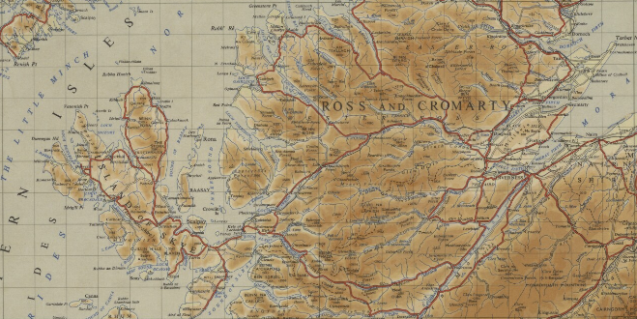
Locational map
Gairloch parish Ullapool
Inverness
7
Isle of Skye Reproduced with permission of NLS
A1

Slide 4
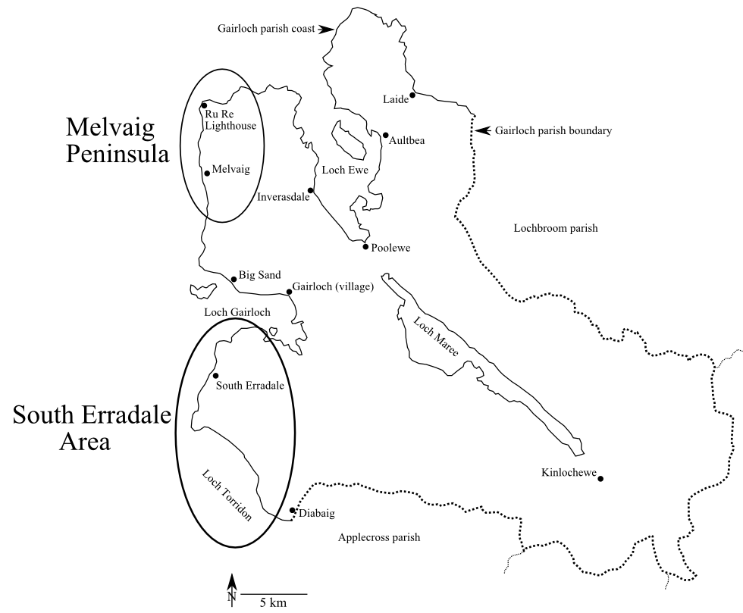
Gairloch parish
A2

Slide 5
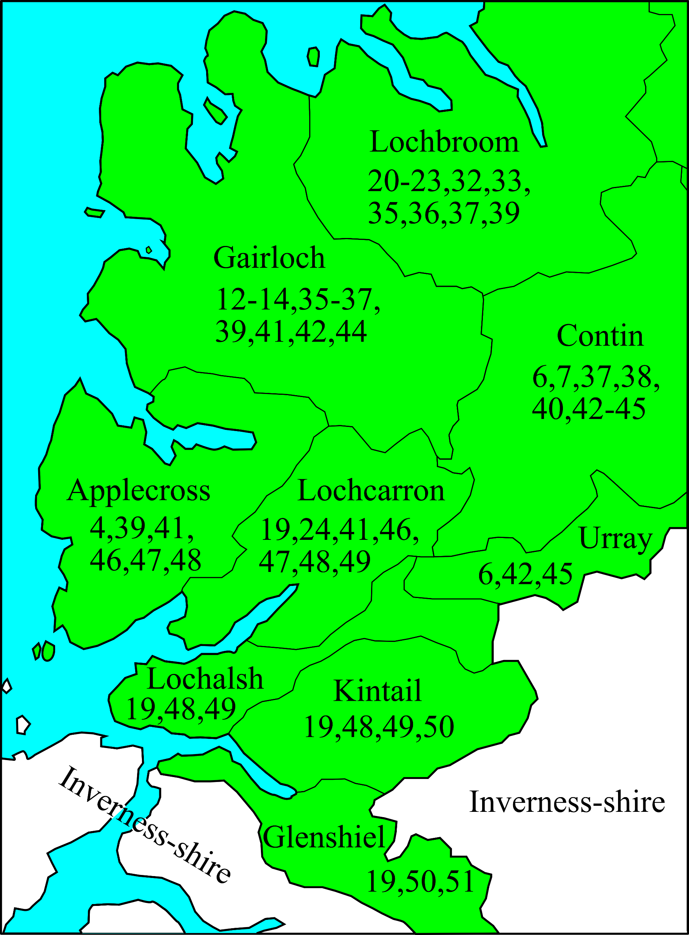
OSNB basics
Search: scotland places name books
Wester Ross name books for
each parish
B

Slide 6
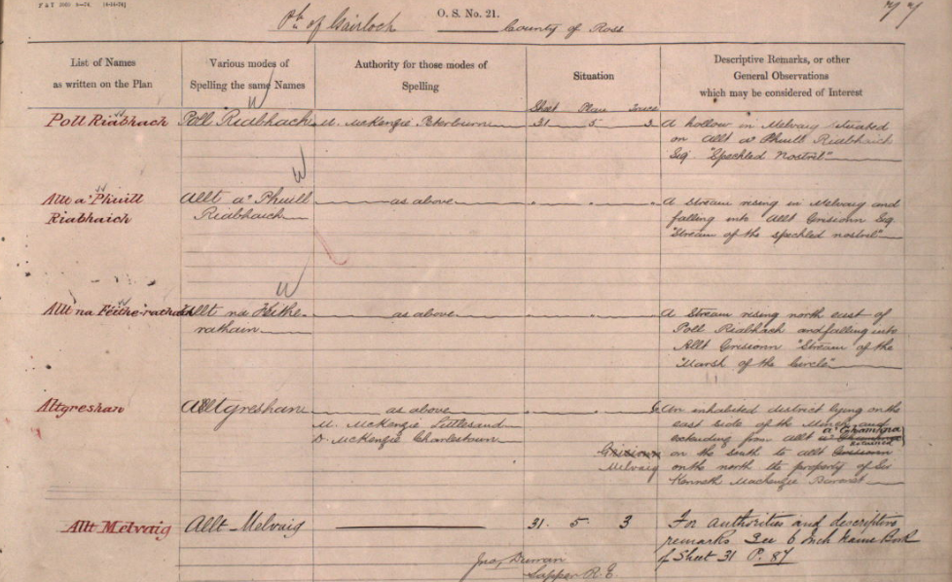
A sample OSNB page: neat and clearly laid out
OS1/28/12/77
B2

Slide 7
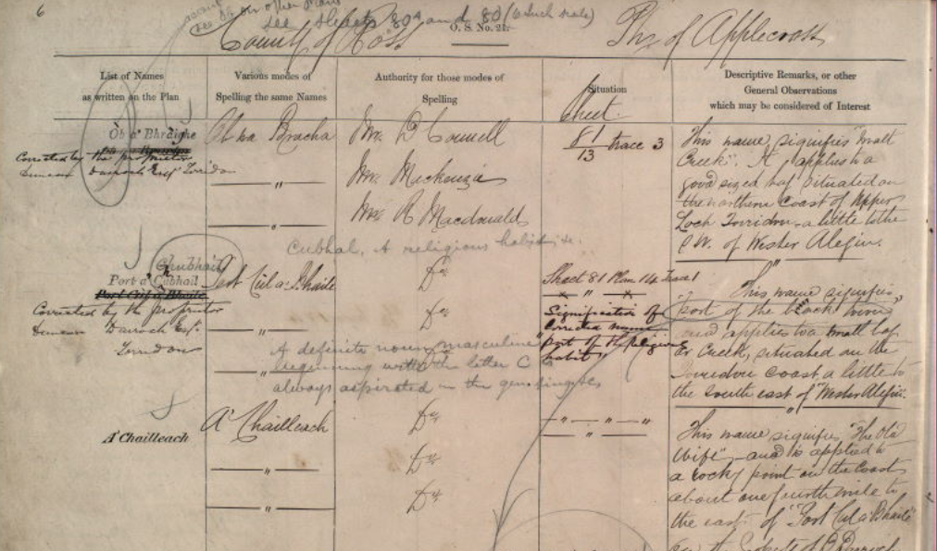
A sample OSNB page: multiple annotations
OS1/28/4/6
B3

Slide 8
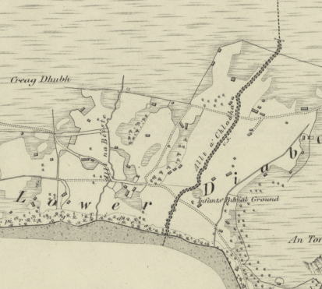
The limited
number of
names on
OSNBs
The few names on 1st edition
map of Lower Diabaig,
grid sq. NG7960
D

Slide 9
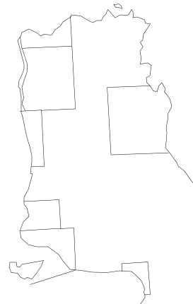
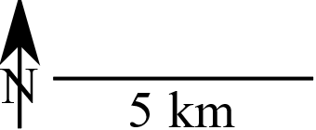
Number of OSNB names v. total collected, 1
Melvaig Peninsula
213%
129%
532%
Average 274%
358%
248%
303%
Loch Gairloch
D1

Slide 10
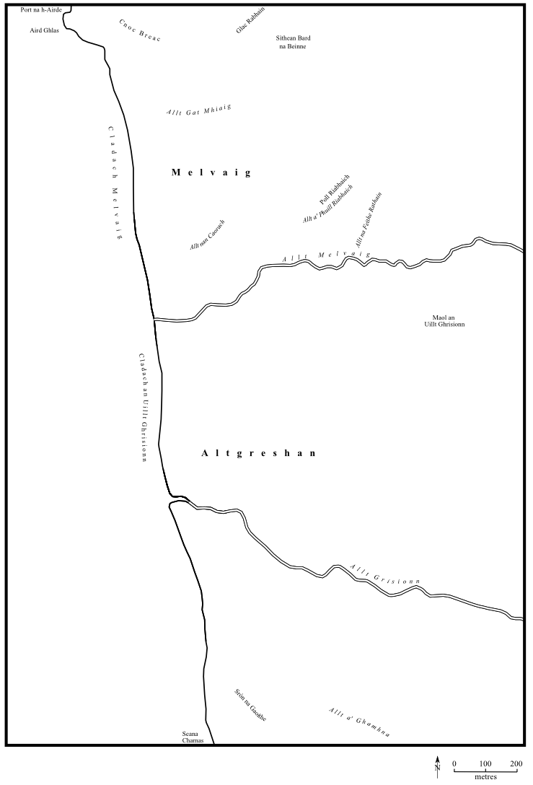
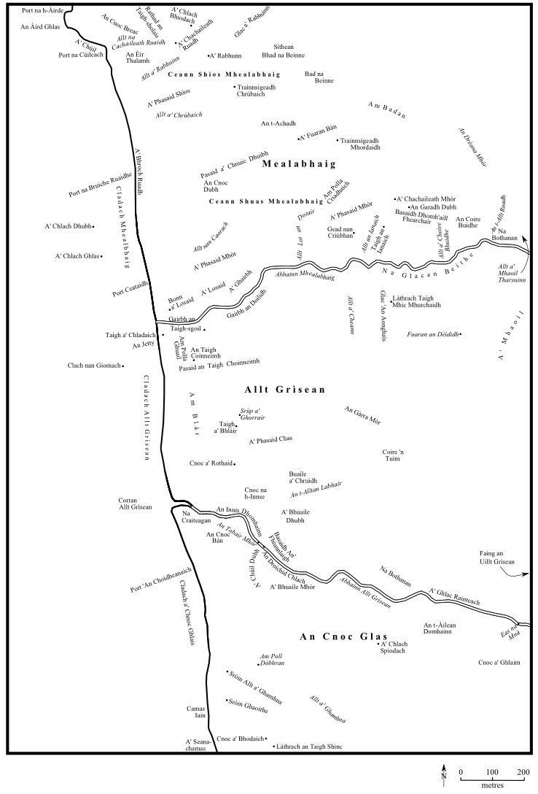
Names
collected
by the
Ordnance
Survey,
1875
Names
collected
by
Roy Wentworth
and
Nevis Hulme,
1986-2004
Gaelic
Mealabhaig
Allt Grìsean
English
Melvaig
Aultgrishan
D2

Slide 11
Number of OSNB names v. total collected, 2
South Erradale Area
651 distinct place-names from 31 informants
compared with
115 given in OSNBs from 5 informants
(566%)
Lower Diabaig (NG7960) 96 v. 5 = 1920%
Loch Gairloch
D3

Slide 12
An analysis of
name categories
E

Slide 13
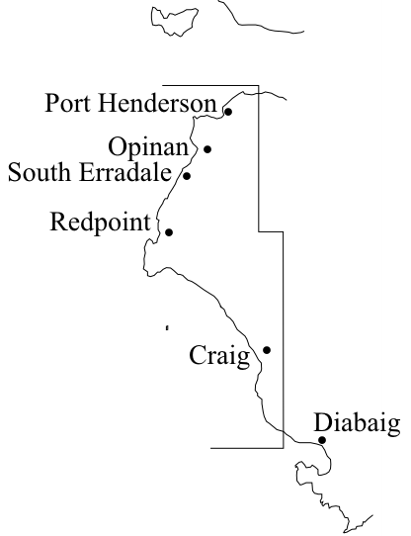
Location of analysis area
South Erradale Area
An area of moorland, coast
and crofting townships
Loch Gairloch
LochTorridon
E2

Slide 14
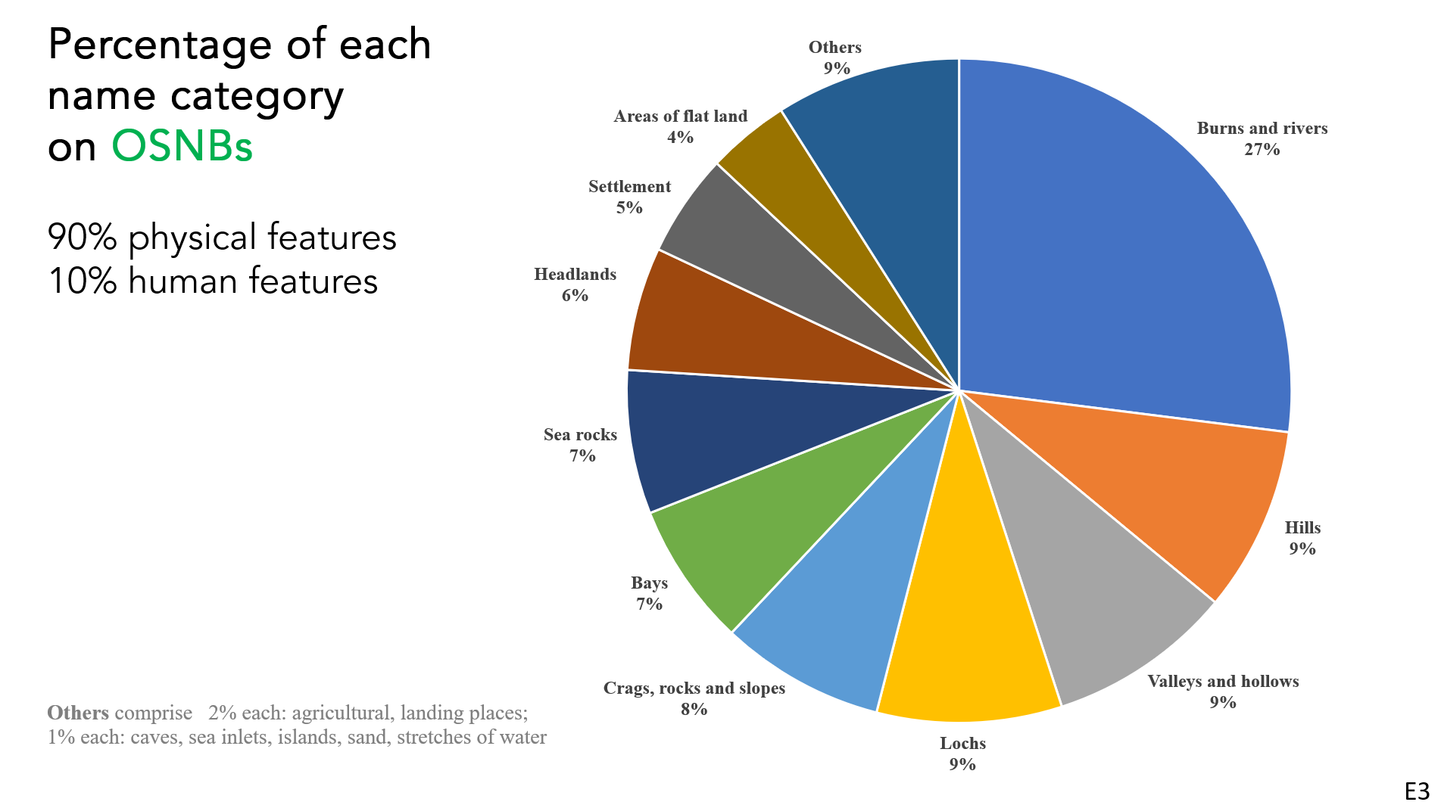
E3

Slide 15
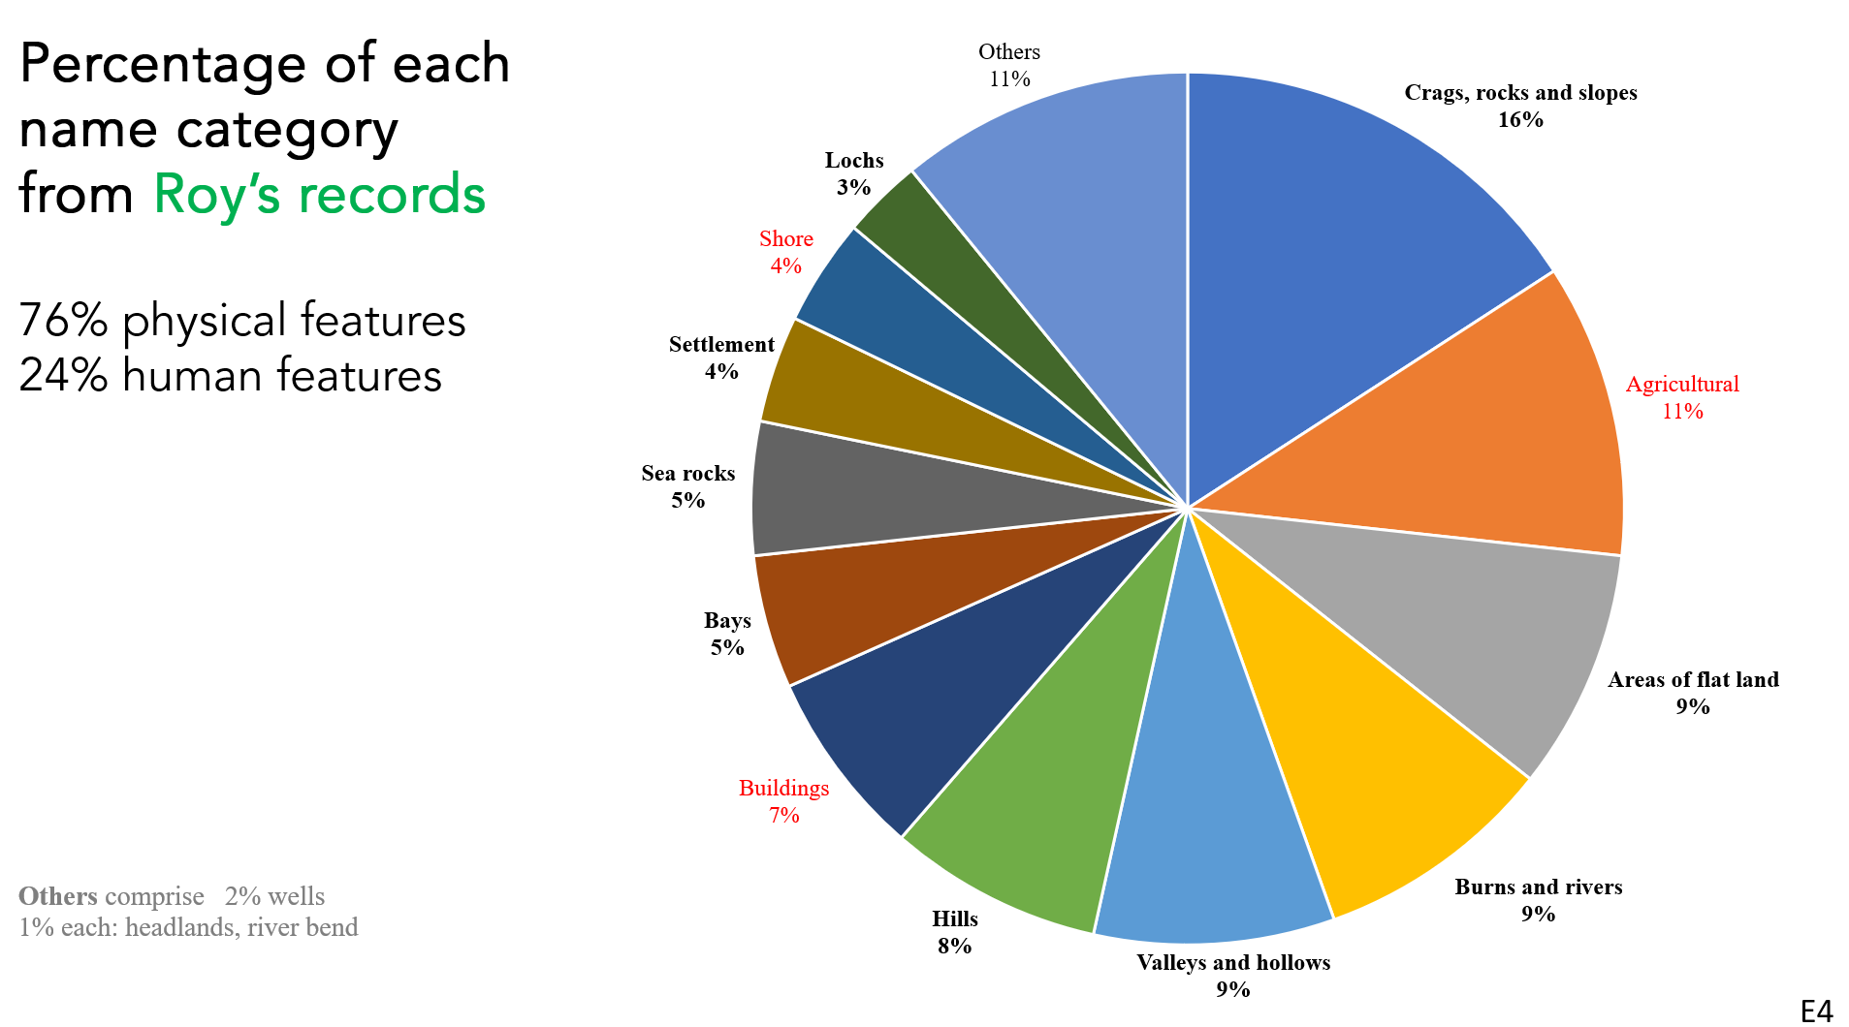
E4

Slide 16
Comparison between O.S. names and Roy’s records
(%, all categories)
red: major difference between OSNB
and Roy’s records
Category | O.S. names | Roy’s records
Burns and rivers | 27 | 9
Hills | 9 | 8
Valleys and hollows | 9 | 9
Lochs | 9 | 3
Crags, rocks and slopes | 8 | 16
Bays | 7 | 5
Sea rocks | 7 | 5
Headlands | 6 | 1
Settlement | 5 | 4
Areas of flat land | 4 | 9
Others | 9 | 31
E5

Slide 17
Comparison between O.S. names and Roy’s records
(%, main O.S. categories)
the main differences
remain when categories
largely ignored by the
O.S are removed
Category | O.S. names | Roy’s records
Burns and rivers | 30 | 13
Hills | 10 | 12
Valleys and hollows | 10 | 13
Lochs | 10 | 5
Crags, rocks and slopes | 8 | 23
Bays | 7 | 7
Sea rocks | 7 | 7
Headlands | 6 | 1
Settlement | 5 | 6
Areas of flat land | 5 | 14
E6

Slide 18
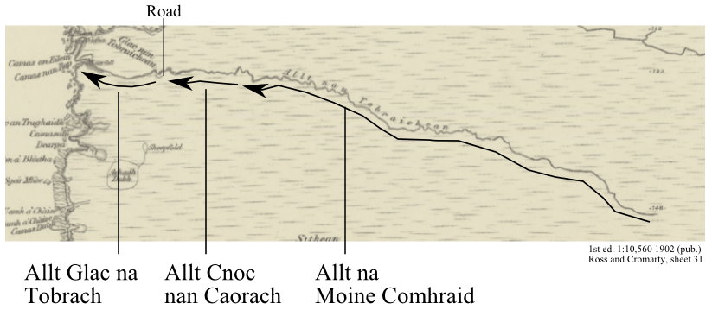
An example of a burn with multiple names
The O.S. gives it one name: Allt nan Tobraichean
E7

Slide 19
An analysis of
the reliability of
OSNBs
F

Slide 20
OSNB names compared with those collected 1984-2001
1. Places with no names recorded since OSNBs (all 3 names)
 |  | Associated nearby names
 | OSNB names | OSNB names | Roy’s records
1 | Caol Tholl | Allt a’ Chaol Thuill | Allt a’ Chaoldoiridh
2 | Glac Gheal | Lochan na Glaic Gille | Lochan na Clachan Geala
3 | Cnoc nan Caorach | - | -
F2

Slide 21
OSNB names compared with those collected 1984-2001
2. Anglicised on O.S. (all 6 names)
Red bold: settlements
Black: physical features
 | O.S. names | Roy’s records
1 | Port Henderson | Portaigil
2 | Openham | Na h-Òbaidhnean
3 | South Erradale | Eàrradal Shuas
4 | Red Point (headland) | A' Rubha Lachdonn or A’ Rubha Dearg
5 | Craig | Creag Ri’ Mhorgainn
6 | Craig River | Abhainn na Creige
F3

Slide 22
OSNB names compared with those collected 1984-2001
3. Same or recognisably similar names (a selection of the 85 names)
 | O.S. name | Roy’s records | Commentary
1 | Allt Loch nan Gillean | Allt Loch nan Gillean | identical
2 | Caolas Dubh | An Caolas Dubh | definite article omitted (O.S. policy)
3 | Allt a’ Mhadaidh Ruaidh | Allt a’ Mhada Ruaidh | local spelling variation
4 | Camas an Alltain | Camas an Alltan | dialect omission of genitive
5 | Sgeir Ghlas | A' Sgeire Ghlais | dative-locative
6 | Glac nan Cuilc | A' Ghlac Cuilc | Wester Ross form standardised
7 | Creag na Luatha | A’ Chreag Luathann | different genitives (latter local)
F4.1

Slide 23
OSNB names compared with those collected 1984-2001
3. Same or recognisably similar names (a selection of the 85 names)
 | O.S. name | Roy’s records | Commentary
1 | Allt Loch nan Gillean | Allt Loch nan Gillean | identical
2 | Caolas Dubh | An Caolas Dubh | definite article omitted (O.S. policy)
3 | Allt a’ Mhadaidh Ruaidh | Allt a’ Mhada Ruaidh | local spelling variation
4 | Camas an Alltain | Camas an Alltan | dialect omission of genitive
5 | Sgeir Ghlas | A' Sgeire Ghlais | dative-locative
6 | Glac nan Cuilc | A' Ghlac Cuilc | Wester Ross form standardised
7 | Creag na Luatha | A’ Chreag Luathann | different genitives (latter local)
F4.2

Slide 24
Two examples of variants from Roy’s records
Of the 651 distinct names, 117 have at least one variant:
92 with 1; 19 with 2; 2 with 3; 2 with 4; 2 with 6.
Coire an t-Slèibhe (OSNB, NG7666)
Coire ’n t-Slèibhe Coire ’n t-Slèibh Na Coireachan Slèibh Na Coireachan Slèibhe Na Coireachan Slèibheach Na Coireachan Sliabh
Coireachan an t-Slèibh
(No name in OSNB, NG7469) Doire Sriùmpag
Doire ’n t-Sriùmpan
Doire ’n t-Srampag
Doire Srampag
Doire Sriùmpaid
F5

Slide 25
OSNB names compared with those collected 1984-2001
4. Inconsistent names (a selection of the 21 names)
 | O.S. names | Roy’s records | Commentary
1 | Caochan na Gainimh | Allt a’ Hal | unrelated names
2 | Lochan na Glaic Gille | Lochan na Clachan Geala | corruption
3 | Caolas Dubh | Camas an Duilisg | O.S. name misplaced
4 | Loch Airidh Uilleim | Loch Àirigh Sitheag | change of specific
5 | Allt Uamhach Chliabh | Allt Cùl Creagan Ùmh ’Chlèibh | expanded from OSNB
6 | Achadh Uamhach Chléibh | Buail’ Ùmh ’Chlèibh | change of generic
F6.1

Slide 26
OSNB names compared with those collected 1984-2001
4. Inconsistent names (a selection of the 21 names)
 | O.S. names | Roy’s records | Commentary
1 | Caochan na Gainimh | Allt a’ Hal | unrelated names
2 | Lochan na Glaic Gille | Lochan na Clachan Geala | corruption
3 | Caolas Dubh | Camas an Duilisg | O.S. name misplaced
4 | Loch Airidh Uilleim | Loch Àirigh Sitheag | change of specific
5 | Allt Uamhach Chliabh | Allt Cùl Creagan Ùmh ’Chlèibh | expanded from OSNB
6 | Achadh Uamhach Chléibh | Buail’ Ùmh ’Chlèibh | change of generic
F6.2

Slide 27
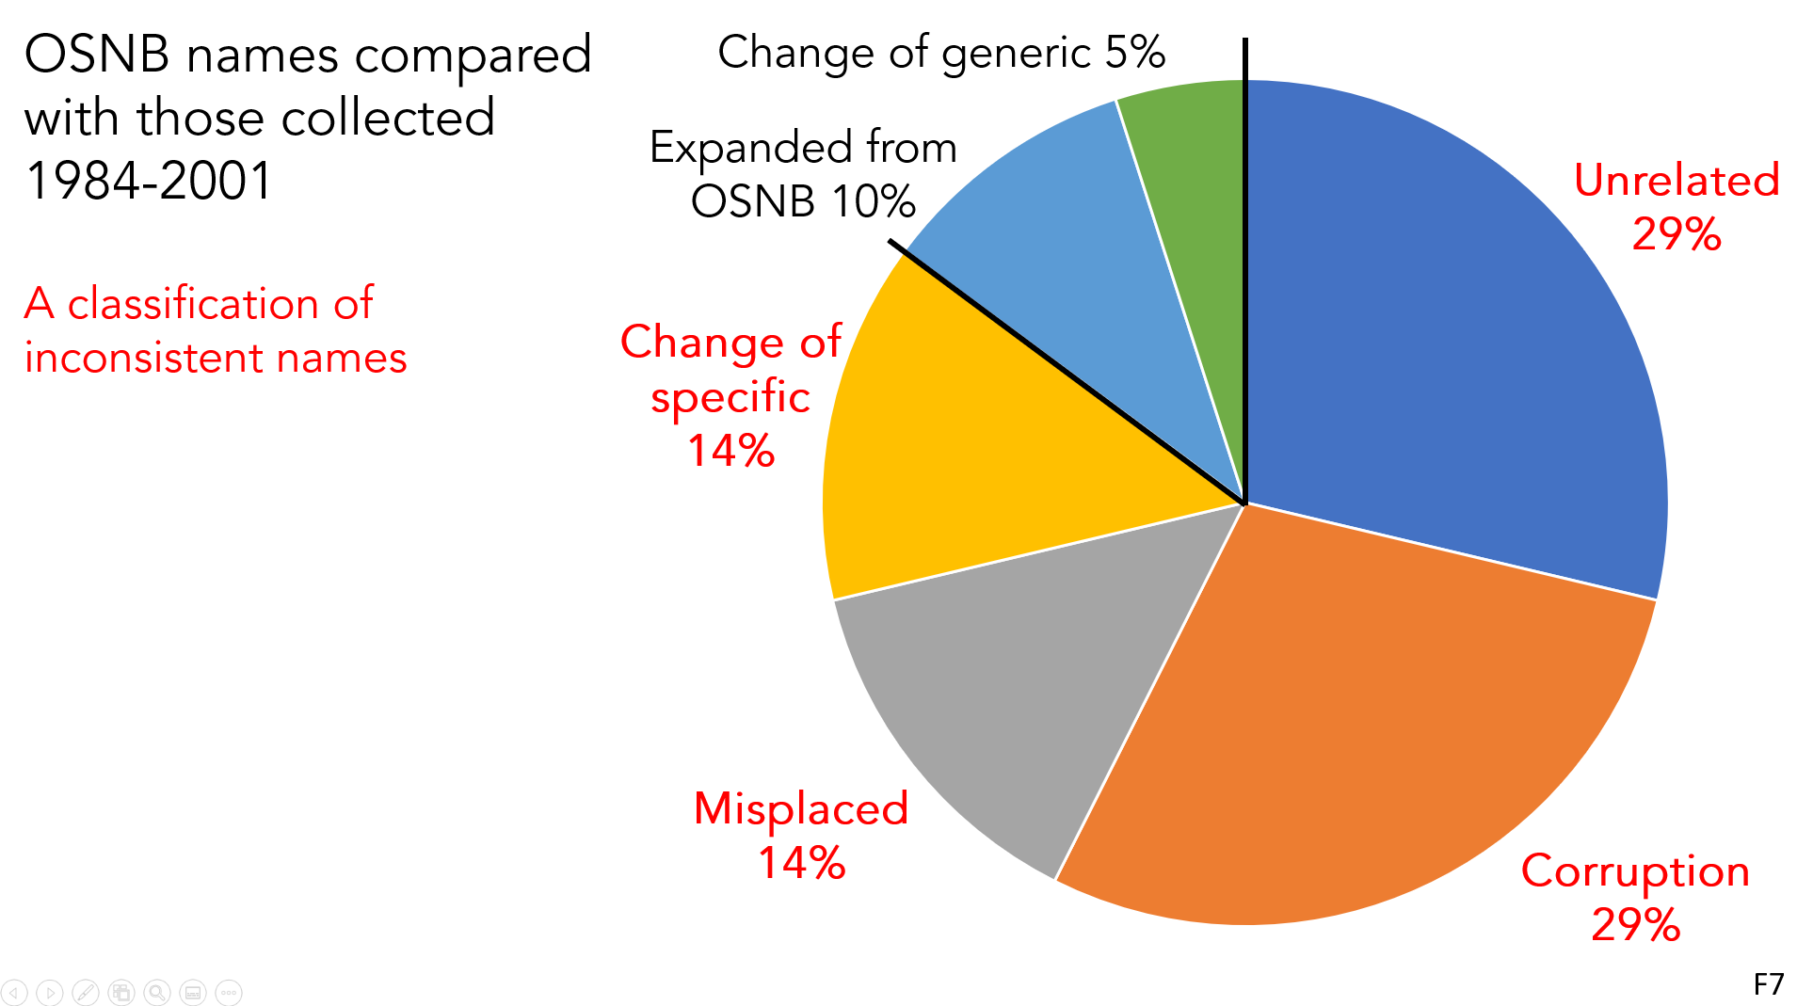
F7

Slide 28
The reliability of
the authorities
G

Slide 29
Instructions to Field Examiners of 1884
For names generally the following are the
best individual authorities, and should be taken in the order given :
Owners of property ; estate agents ; clergymen, postmaster and schoolmasters, if they have been some time in the district ; rate collectors ; road surveyors; borough and county surveyors ; gentlemen residing in the district, . . .
Respectable inhabitants of some position should be consulted.
Small farmers or cottagers are not to be depended on, even for the names of places they occupy, especially as to the spelling, but a well-educated and intelligent occupier is, of course, a good authority.
G2

Slide 30
The South Erradale Area authorities
crofter
OS1/28/39/112
farmer
OS1/28/39/215
gamekeeper
farmer
OS1/28/39/110
(K. Mackenzie)
G3.1

Slide 31
The South Erradale Area authorities
crofter
OS1/28/39/112
farmer
OS1/28/39/215
gamekeeper
farmer
OS1/28/39/110
(K. Mackenzie)
G3.2

Slide 32
An unexpected find: my great great-grandfather
OS1/1/90/27 (Aberdeenshire)
G4

Slide 33
Thanks to the following who helped with aspects of this talk
Carole Hough, Dorothy Malone (Gairloch), Eila Williamson
Gairloch Museum
Are there any questions?
Nevis Hulme
nevis@live.ie

